Slide 1
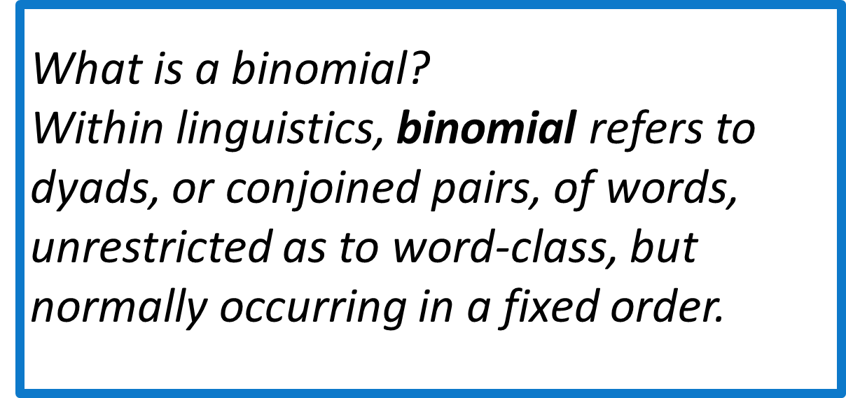
The influence of binomials frequency
and word order on their processing
in Chinese-Russian bilinguals*
Aleksandra S. Bub
Tomsk State University, Laboratory of Linguistic Anthropology
Introduction
Further study
Problem statement
Main research goal
Research questions
Every word has a collocational field, or span – a range of other words with which it normally collocates.
Knowledge of collocations is a key to language fluency.
For second language learners, developing a mental lexicon with strong collocational links between words is key to becoming a proficient speaker and reader.
Despite the fact that English binomials are sufficiently studied within the European linguistic tradition, the studies of the Russian language binomials are very scarce and the position of these units in the Russian language is yet to be defined.
The study aims to investigate Russian binomial processing in monolinguals and bilinguals.
Individuals who can quickly recognise or produce collocations such as binomials will be more effective communicators than those who are slower to process the relations between terms.
Our hypothesis
We hypothesize that the frequency and the order of constituents of a binomial are two factors influencing the reaction time in adult bilinguals.
Does the frequency of binomials influence their processing?
Does the order of binomials constituents influence the reaction time during their processing?
What other factors affect the processing of Russian binomials in bilinguals?
What will be done
Experiment setup
Participants will be asked to indicate whether or not an expression such as ‘king and queen’ is presented in its ‘usual way’.
Expressions will be normal (symmetrical) or reversed (asymmetrical, e.g. ‘queen and king’). The task will be presented via DMDX on a computer, and participants will respond yes/no via pre-assigned keys on the keyboard.
90 binomials will be presented: 20 normal high frequency, 20 normal low frequency, 20 reversed high frequency, 20 reversed low frequency, and 10 random expressions.
What has been done
Tasks
Investigate whether such type of collocations as binomials are characteristic for the Russian language.
Make a list of Russian binomials of different frequency based on the Russian National Corpus data and the results of psycholinguistic survey for further use in experiments with bilinguals.
Procedures
Participants
A group of Chinese – Russian bilinguals will be an experimental group.
Approximately 50 participants.
We also aim to recruit about 60 bilinguals from Shor region and Khakassia as well as Tatar-Russian bilinguals.
A list of binominals was made on the basis of previous research an Russian National Corpus.
The objective frequency data were taken from Russian National Corpus..
The subjective frequency ranks were obtained from psycholinguistic survey.
A nonparametric analysis of the data was carried out using Spearman's rank correlation method, showing statistically significant correlation between subjective frequency estimates and objective frequency rates.
Results
Table 1.Examples of binomials and their frequency.
Spearman’s Rank correlation
Significant correlations at p<,05000
 | frq_ob | frq_sub
frq_ob | 1 | 0,61692
frq_sub | 0,61692 | 1
A corpus of Russian binomials was made for further use in psycholinguistic experiments.
Each binomial has been ascribed its objective frequency index and received subjective frequency estimation.
The units were ranked according to the averaged and discursively determined frequency of their use in Russian speech.
The scope of variation of the discursively determined frequency of binomials in the oral, newspaper, and poetic subcorpora was determined.
Contact
References
Morita M., & Wylie, J., Productive knowledge of English binomials by Japanese learners of English // Hiroshima studies in language and language education, (19), P. 83-92.
Nagel O. V., Temnikova I. G., Wylie J., Koksharova N. Functional Bilingual-ism: Definition and Ways of Assessment // Procedia - Social and Behavioral Sciences. 2015. Vol. 215. P. 218–224
http://www.ruscorpora.ru/
Aleksandra S. Bub
Laboratory of Cognitive anthropology, TSU
Email: aleksandrabub@yanex.ru
*Research is supported by the Ministry of Education and Science of the Russian Federation [grant number 14.Y26.31.0014].

