Slide 1
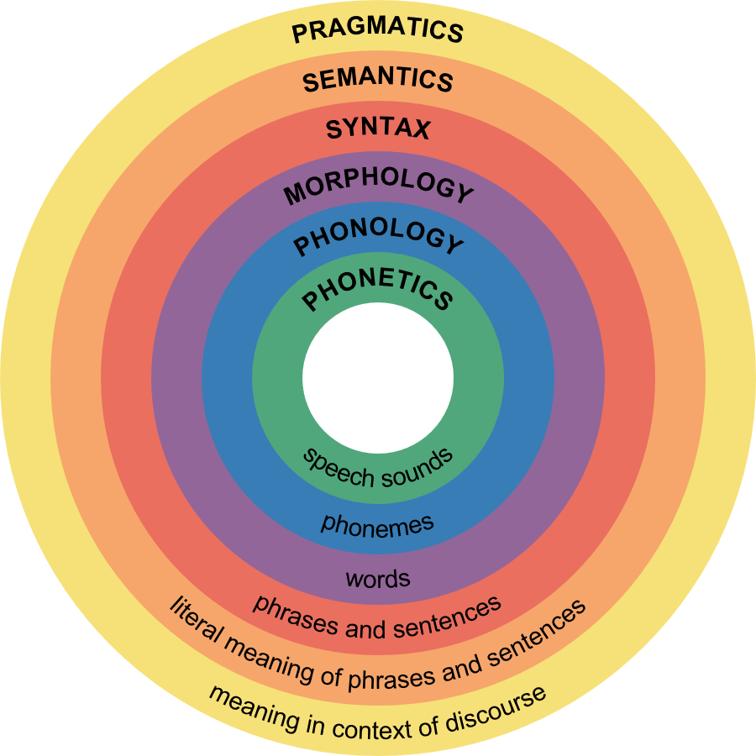
Measuring a Lexical Component of the Language Faculty: Developing a Test Battery
Aleksandra Nabiullina, Postgraduate Student; Zoya Rezanova, Doctor
Laboratory of Linguistic Anthropology*
INTRODUCTION
METHODS
Measuring language faculty (language ability, linguistic ability) has interested researchers for many years.
The structure of the language faculty usually reflects the structure of language.
Our research focuses on words as a lexical component of the language faculty.
Lexical component is the main one in the structure of the language faculty since it is measurable and testable.
Among the tests measuring language faculty the Mill Hill Vocabulary Test is considered to be one of the most effective tools which is determined by:
regular modification since the 1930s;
reproducibility;
cross-cultural validity;
standardizations for many languages.
Standardized tests serve as a good tool for cross-cultural studies. However, to the best of our knowledge there are no accurately standardized tests for the Russian language that can be used across the country. Replication is considered to be the most effective method of standardization of a test.
The aim of the present work is to develop a Russian version of the MHV.
Standardization of a test can be made by ordinary translation or replication. The latter is proved to be more effective. It takes into account the specifics of a language and increases the validity of a test.
 | Original Version | Russian Version
STAGE 1 | 500 words from Concise Oxford English Dictionary | 500 words from Small Academic Dictionary
STAGE 2 | Expertise (children) | 500 words from Frequency Dictionary of Russian
STAGE 3 | 150 words from Roget’s Thesaurus | Expertise (linguists/adults)
STAGE 4 | 112 words | 154 words
STAGE 5 | Arrangement by frequency and difficulty (Fig. 1) | Arrangement into 4 groups of 38 and 39 words
STAGE 6 | Preliminary testing | Preliminary testing
STAGE 7 | Modification | Modification (on-going)
STAGE 8 | Testing
FINAL STAGE | 88 words
Table 1. Comparison of the English and
Russian versions
Figure 1. Word grouping in the scale
Preliminary testing
STIMULUS
DISTRACTER | DISTRACTER
SYNONYM | DISTRACTER
DISTRACTER | DISTRACTER
Setting: Secondary schools in Tomsk and Prokopievsk
Number of respondents:
37 pupils from 5 grade
25 pupils from 6 grade
51 pupils from 8 grade
Total: 113
Number of reactions: 4,354
Figure 1. Word grouping
Discussion
Most selected words manifested their testing ability. However, According to Fisher test 1/3 needs reviewing and further testing since it does not reveal any differences between two groups of respondents.
Words need to be arranged by frequency, distracters and synonyms need reviewing since they also differ from stimuli in frequency, difficulty, or length, which was obligatory in the original version.
Sample needs increasing the number of respondents and age difference to obtain data that are more accurate.
DATA PROCESSING
Google-forms confirmed that selected words are known to people whose language faculty is thought to be fully developed.
Preliminary processing in Excel illustrated the completeness of each set individually and in groups.
Fisher test measured and compared the number of correct answers in two groups.
RESULTS
The results of the research will allow us to design a test that can provide information on several aspects of the language and measure individual and averaged language ability of native speakers and those who study Russian as L2.
References:
Raven, J., Raven, J. C., & Court, J. H. (1998). Manual for Raven’s Progressive Matrices and Vocabulary Scales. Section 5: The Mill Hill Vocabulary Scale. San Antonio, TX: Harcourt Assessment.
Raven, J. Lessons Learned while Developing a Romanian Version of the Mill Hill Vocabulary Test. (1998). Manual for Raven’s Progressive Matrices and Vфocabulary Scales. Chapter 6: Lessons from Pilot Analyses of Romanian MHV. 160-172.
Pietroski P., Crain S. The Language Faculty. In The Handbook of Philosophy of Cognitive Science (E. Margolis, R. Samuels, and S. Stich, eds.), Oxford University Press (2011).
Pinker S., Jackendoff R. The Faculty of Language: What’s Special about it? (2005). Cognition, 95: 201-236.
Hauser M. D., Chomsky N., Tecumseh Fitch W. (2002). The Faculty of Language: What Is It, Who Has It, and How Did It Evolve? Science 298: 1569-1579.
Acknowledgment: Research is supported by the Ministry of Education and Science of the Russian Federation [grant number 14.Y26.31.0014].
CONTACT
Aleksandra Nabiullina
Laboratory of Linguistic
Anthropology,
Email: teachepreter@gmail.com
Phone: +79234017445
Zoya Rezanova
Laboratory of Linguistic Anthropology
Email: rezanovazi@mail.ru
Phone: +79039522347

