Slide 1
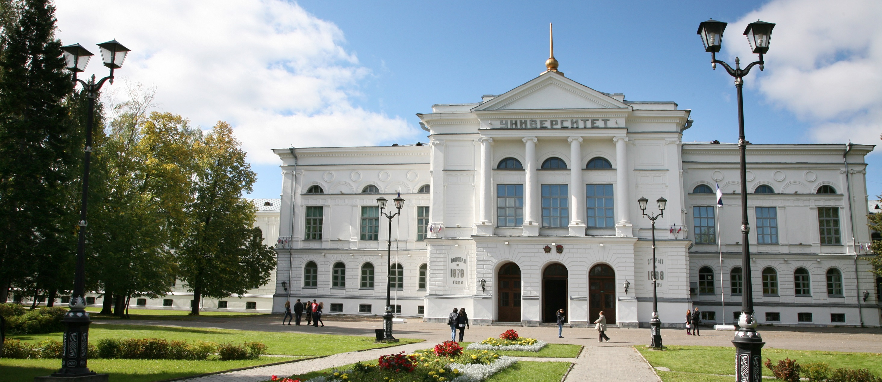
The influence of grammatical gender on the conceptualization of objects by Russian-Spanish bilinguals and native Russian speakers
Lisa Yershova
Laboratory of Linguistic Anthropology

Slide 2
Theoretical framework
Linguistic relativity hypothesis:
was formulated by E. Sapir and B. Whorf;
postulates the influence of language structures on speakers' cognition;
nowadays studied with linguistic and psycholinguistic methods；
much less studied in the field of grammatical categories.
The influence of grammatical gender on the conceptualization of objects by Russian-Spanish bilinguals and native Russian speakers

Slide 3
Research on the effects of grammatical gender on cognition
Boroditsky L., Schmidt L. A., Phillips W. Sex, syntax, and semantics //Language in mind: Advances in the study of language and thought (2003)
Flaherty M. The influence of a language gender system on perception //Tohoku psychologica folia (2000)
Kurinski E., Jambor E., Sera M. D. Spanish grammatical gender: Its effects on categorization in native Hungarian speakers //International Journal of Bilingualism (2016)
Landor R. Grammatical Categories and Cognition across Five Languages: The Case of Grammatical Gender and its Potential Effects on the Conceptualisation of Objects (2014)
Nicoladis E., Da Costa N., Foursha-Stevenson C. Discourse relativity in Russian-English bilingual preschoolers’ classification of objects by gender //International Journal of Bilingualism (2016)
Andonova E. et al. Second language gender system affects first language gender classification //Cognitive aspects of bilingualism. – Springer Netherlands (2007)
Janyan A., Vergilova Y. Biological sex context influences grammatical gender categorization of objects //European Perspectives on Cognitive Science (2011)
Ramos S., Roberson D. What constrains grammatical gender effects on semantic judgements? Evidence from Portuguese //Journal of Cognitive Psychology (2011)
Sera M. D. et al. When language affects cognition and when it does not: An analysis of grammatical gender and classification //Journal of Experimental Psychology: General (2002)
Bassetti B. A. L. Is grammatical gender considered arbitrary or semantically motivated? Evidence from young adult monolinguals, second language learners, and early bilinguals //British Journal of Psychology (2014)
The influence of grammatical gender on the conceptualization of objects by Russian-Spanish bilinguals and native Russian speakers

Slide 4
Research on the effects of grammatical gender on cognition
Koch S. C., Zimmermann F., Garcia-Retamero R. El sol-die Sonne //Psychologische Rundschau (2007)
Bassetti B., Nicoladis E. Research on grammatical gender and thought in early and emergent bilinguals (2016)
Bassetti B. 16 The grammatical and conceptual gender of animals in second language users //Language and bilingual cognition (2010)
Flaherty M. How a language gender system creeps into perception //Journal of Cross-Cultural Psychology (2001)
Konishi T. The semantics of grammatical gender: A cross-cultural study //Journal of psycholinguistic research (1993)
Konishi T. The connotations of gender: A semantic differential study of German and Spanish //Word (1994)
Vigliocco G. et al. Grammatical gender effects on cognition: implications for language learning and language use //Journal of Experimental Psychology: General (2005)
Phillips W., Boroditsky L. Can quirks of grammar affect the way you think? Grammatical gender and object concepts //Proceedings of the 25th annual meeting of the Cognitive Science Society. – Mahwah, NJ : Lawrence Erlbaum Associates (2003)
Cubelli R. et al. The effect of grammatical gender on object categorization //Journal of Experimental Psychology: Learning, Memory, and Cognition (2011)
Rigalleau F., Caplan D. Effects of gender marking in pronominal coindexation //The Quarterly Journal of Experimental Psychology: Section A. (2000)
The influence of grammatical gender on the conceptualization of objects by Russian-Spanish bilinguals and native Russian speakers

Slide 5
Grammatical category of gender
Grammatical gender is a morphosyntactic feature found in various languages, whereby nouns are assigned to classes called ‘genders’ (Corbett, 2006).
Grammatical gender of nouns is a classifying and obligatory category.
Russian:
3 classes of grammatical gender (masculine, feminine, neuter);
no articles;
Spanish:
2 classes of grammatical gender (masculine and feminine);
English:
no grammatical category of gender.
The influence of grammatical gender on the conceptualization of objects by Russian-Spanish bilinguals and native Russian speakers

Slide 6
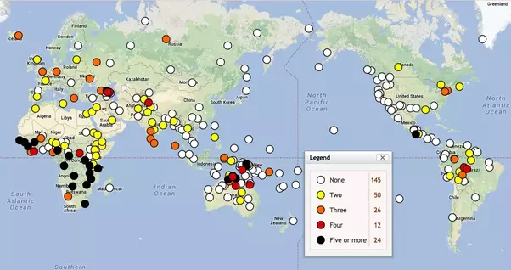
Number of grammatical gender categories
The influence of grammatical gender on the conceptualization of objects by Russian-Spanish bilinguals and native Russian speakers

Slide 7
The effects of grammatical gender on bilinguals
How do bilinguals store and process grammatical gender if their two languages have different genders for the same referent?
Does knowledge of more than one language link with a decrease in the effects of grammatical gender on thinking?
Can learning an additional language that has a grammatical gender induce novel gender biases?
The influence of grammatical gender on the conceptualization of objects by Russian-Spanish bilinguals and native Russian speakers

Slide 8
Methods
voice/name attribution tasks
semantic differential techniques
paired associate learning tasks
similarity rating tasks
with words
with pictures*
*L. Boroditsky & W. Philips (2003)
The influence of grammatical gender on the conceptualization of objects by Russian-Spanish bilinguals and native Russian speakers

Slide 9
Our study
Hypothesis:
The differences in the grammatical categorization of nouns in Russian and Spanish languages would influence the perception of objects by the native speakers of these languages and bilinguals.
The influence of grammatical gender on the conceptualization of objects by Russian-Spanish bilinguals and native Russian speakers

Slide 10
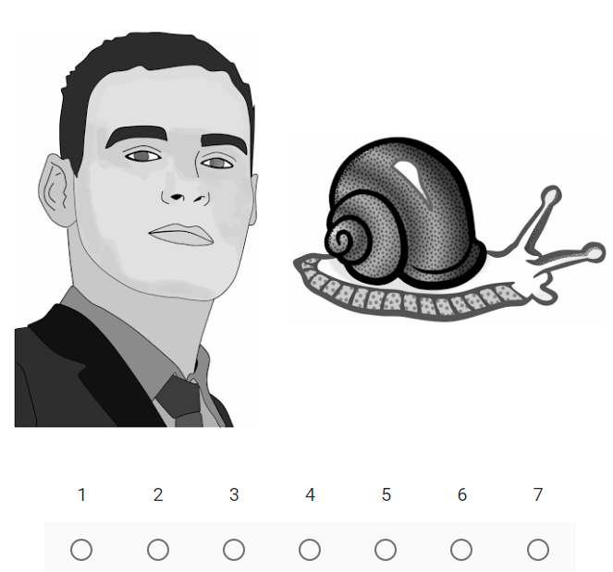
Instruction for participants*:
“You will see pairs of pictures on the screen. In each pair, there will be a picture of a person and a picture of an object or animal. Your task is to tell us how similar you think the two things being depicted are on the scale from 1 to 7 (1=not similar and 7=very similar). Please use the whole scale (give some 1's and some 7's and some of all the numbers in-between)”.
*the instruction was given in Russian
The influence of grammatical gender on the conceptualization of objects by Russian-Spanish bilinguals and native Russian speakers

Slide 11
Materials
M in Russian, F in Spanish:
F in Russian, M in Spanish:
стул – la silla (chair)
велосипед – la bicicleta (bicycle)
дом – la casa (house)
якорь – la áncora (anchor)
муравей – la hormiga (ant)
лист – la hoja (leaf)
колокольчик – la campanilla (bell)
вилка – el tenedor (fork)
книга – el libro (book)
улитка – el caracol (snail)
скрипка – el violín (violin)
пуговица – el botón (button)
акула – el tiburón (shark)
кукуруза – el maíz (corn)
The influence of grammatical gender on the conceptualization of objects by Russian-Spanish bilinguals and native Russian speakers

Slide 12
Participants
FIRST GROUP
SECOND GROUP
25 native Russian speakers
students and graduates of Tomsk universities;
60% estimated their level of proficiency in English as “average”;
did not speak any other foreign languages.
32 Russian-Spanish bilinguals
students and graduates of faculties of foreign languages;
late functional bilinguals with Russian as native and dominant language.
The influence of grammatical gender on the conceptualization of objects by Russian-Spanish bilinguals and native Russian speakers

Slide 13
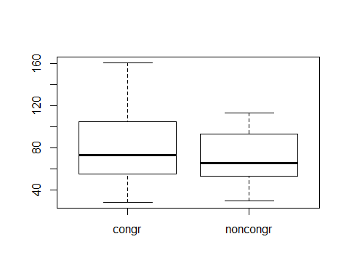
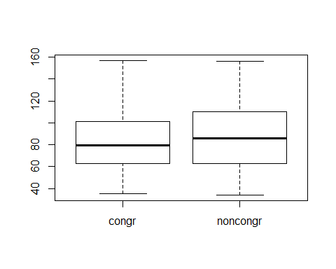
Results of the first experiment
Fig. 1. Difference in ratings of congruent and incongruent pairs in the group of native Russian speakers (p < .05)
Fig. 2. Difference in ratings of congruent and incongruent pairs in the group of Russian-Spanish bilinguals (p > .05)
The influence of grammatical gender on the conceptualization of objects by Russian-Spanish bilinguals and native Russian speakers

Slide 14
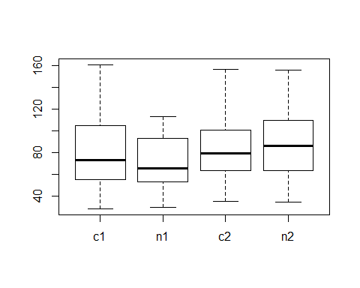
Results of the first experiment
Fig. 3. Difference in samples of two groups
for congruent p > .05
for incongruent p < .05
The influence of grammatical gender on the conceptualization of objects by Russian-Spanish bilinguals and native Russian speakers

Slide 15
Materials for the second experiment
M in Russian and Spanish
F in Russian and Spanish
дельфин – el delfìn (dolphin)
карандаш – el lápiz (pencil)
самолет – el avión (airplane)
зонт – el paraguas (umbrella)
помидор – el tomate (tomato)
свисток – el silbato (whistle)
жук – el escarabajo (bug)
ложка – la cuchara (spoon)
тыква – la calabaza (pumpkin)
лампочка – la bombilla / lámpara eléctrica (light bulb)
пальма – la palmera (palm)
звезда – la estrella (star)
ракетка – la raqueta (racket)
зебра – la cebra (zebra)
The influence of grammatical gender on the conceptualization of objects by Russian-Spanish bilinguals and native Russian speakers

Slide 16
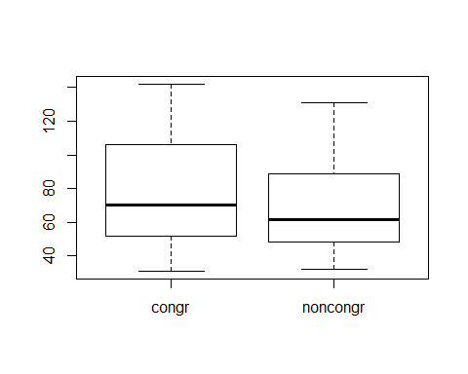
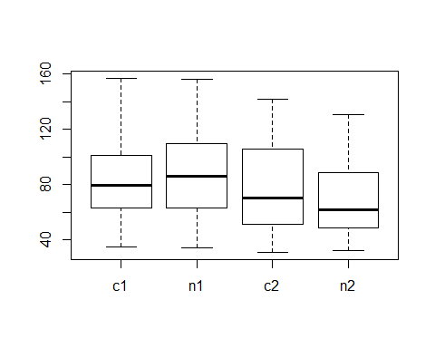
Results of the second experiment
Fig. 4. Difference in ratings of congruent and incongruent pairs in the group of Russian-Spanish bilinguals (p < .01)
Fig. 5. Difference in samples of Russian-Spanish bilinguals in the 1st (c1, n1) & 2nd (c2, n2) experiments (for congruent p > .05, for incongruent p < .05)
The influence of grammatical gender on the conceptualization of objects by Russian-Spanish bilinguals and native Russian speakers

Slide 17
Conclusions
The results of the study show the influence of Russian grammatical gender on native Russian speakers.
There is a presence of L2 influence on the Russian-Spanish bilinguals.
There is a difference between the answers of native Russian speakers and bilinguals.
The results are difficult to interpret, and the methodology requires revision and elaboration.
The influence of grammatical gender on the conceptualization of objects by Russian-Spanish bilinguals and native Russian speakers

Slide 18
Thank you!
National Research
Tomsk State University
36, Lenina Avenue, Tomsk, 634050, Russia
Tel.: +7 (3822) 529 852, fax: +7 (3822) 529 585
E-mail: rector@tsu.ru
www.tsu.ru

